Slide 1
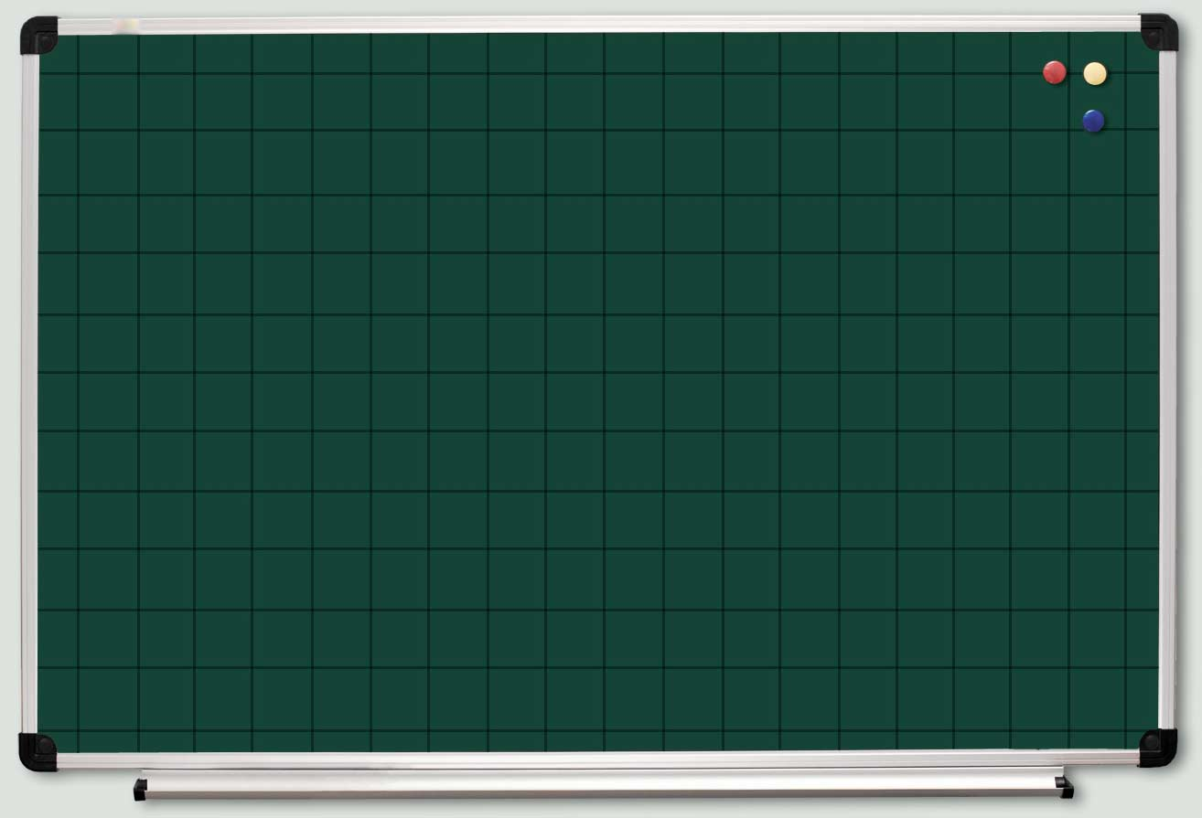
ТАБЛИЦЯ МНОЖЕННЯ ТРЕНАЖЕР

Slide 2
45
48
28
9 ⋅ 5
8 ⋅ 6
7 ⋅ 4
54
35
32
9 ⋅ 6
7 ⋅ 5
8 ⋅ 4
30
40
16
6 ⋅ 5
5 ⋅ 8
4 ⋅ 4

Slide 3
15
27
3 ⋅ 5
14
3 ⋅ 9
2 ⋅ 7
56
24
36
7 ⋅ 8
8 ⋅ 3
6 ⋅ 6
24
81
20
4 ⋅ 6
9 ⋅ 9
5 ⋅ 4

Slide 4
32
49
24
4 ⋅ 8
2 ⋅ 2
7 ⋅ 7
3 ⋅ 8
4
63
24
56
9 ⋅ 7
6 ⋅ 4
8 ⋅ 7
18
30
3 ⋅ 6
5 ⋅ 6

Slide 5
8
2 ⋅ 4
35
72
5 ⋅ 7
9 ⋅ 8
18
42
36
6 ⋅ 3
7 ⋅ 6
9 ⋅ 4

Slide 6
54
14
20
6 ⋅ 9
7 ⋅ 2
4 ⋅ 5
16
18
42
45
8 ⋅ 2
9 ⋅ 2
6 ⋅ 7
5 ⋅ 9
21
40
9
7 ⋅ 3
8 ⋅ 5
3 ⋅ 3

Slide 7
10
5 ⋅ 2
18
2 ⋅ 9
6
2 ⋅ 3
12
16
2 ⋅ 6
2 ⋅ 8
28
15
4 ⋅ 7
8
5 ⋅ 3
12
4 ⋅ 2
12
3 ⋅ 4
6 ⋅ 2

Slide 8
48
63
64
27
25
6 ⋅ 8
7 ⋅ 9
8 ⋅ 8
9 ⋅ 3
5 ⋅ 5
2 ⋅ 5
12
36
72
21
10
4 ⋅ 3
4 ⋅ 9
8 ⋅ 9
3 ⋅ 7

Slide 9
http://microcompany.com.ua/MChtml/pic/Art/Board/BoardS1.jpg доска
http://3.bp.blogspot.com/-aGPVSxK3-IA/UBwlZ4nPzdI/AAAAAAAAAU0/9a6bQ7ykbEs/s1600/69490747_04.png мальчик
http://www.liveinternet.ru/community/4091266/post278276657/ дети
http://liubavyshka.ru/_ph/64/2/610456886.jpg смайл
http://img0.liveinternet.ru/images/attach/c/7/97/380/97380242_5111852_0_6fcb3_d601a429_XL.png рыжая девочка
http://nachalo4ka.ru/vesyolyie-rebyata-deti-shablonyi-dlya-prezentatsiy/ весёлые ребята
http://mallishok.ru/wp-content/uploads/2014/10/d97939c9030a.png девочка
http://img0.liveinternet.ru/images/attach/c/11/115/600/115600306_large_114.png учитель
http://www.clker.com/cliparts/9/6/8/d/13485457861877586130cartoonchildren-hi.png дети
http://mediasubs.ru/group/uploads/mo/mozaika-zhizni-sobiraem-slovo-schaste/image2/DdhMWUtZj.gif

